Slide 1
Small-scale Crop Mapping using Artificial Intelligence/Machine Learning (AI/ML)
Proposal Presentation
by
Jomo Kenyatta University of Agriculture & Technology (JKUAT )
Notes:
Good morning, members of the panel, the Kenya Space Agency Secretariat, and fellow colleagues from the other esteemed institutions of higher education.
Thank you for this opportunity to present our proposal. My name is Eunice Nduati and I will be making the presentation entitled small-scale crop mapping using artificial intelligence and machine learning on behalf of the team from JKUAT.

Slide 2
Background: Small-scale Crop Farming
FAO defines “small-scale food producers” on the basis of two criteria:
Physical size
Economic size (FAO, 2018)
The definition of smallholder farms on the basis of physical size is highly variable and contextual, ranging from 0.2 to 0.5 ha and 2 to 5 ha.
Based on land size, 80% of farms in Kenya are small-scale/ smallholder farms.
Crop cultivation contributed 16.6% to Kenya’s GDP in 2020.
Notes:
In 2018, the Food and Agriculture Organization (FAO) proposed to define small-scale food producers using a combination of two criteria.
The first one is on the basis of the physical size of the food producer, as expressed by the amount of land under crop production and number of livestock heads in production, and the second criterion is on the basis of the economic size of the food producer, as expressed by its revenues.
Other Definitions of “small-scale food producers” that are found in scientific literature and in policy documents are mostly based on four criteria, including:
Size of operated land, amount of labour input employed for agricultural production (especially of family members), market orientation and economic size of the holding.
Land size is the most commonly used criterion, and based on a 2006 national household survey, Kenya’s ministry of agriculture defines small-scale or smallholder farmers as those working land between 0.5 Ha or 1.2 acres and 5 Ha, that is 12.3 acres.
Other definitions for small scale farms provide for a range of between 0.2 Ha or 0.5 acres and 2 Ha, that is 5 acres.
As such, the definition of small-scale farming on the basis of physical size is highly variable and contextual, but it is generally agreed upon that the parcels of land that are under cultivation or livestock production, are small.
Smallholder agriculture, and in particular crop cultivation is an important part of Kenya’s economy. According to the Kenya Economic Survey (2021), the percentage contribution of crop cultivation to the Gross Domestic Product (GDP) in 2020 was 16.6%.

Slide 3
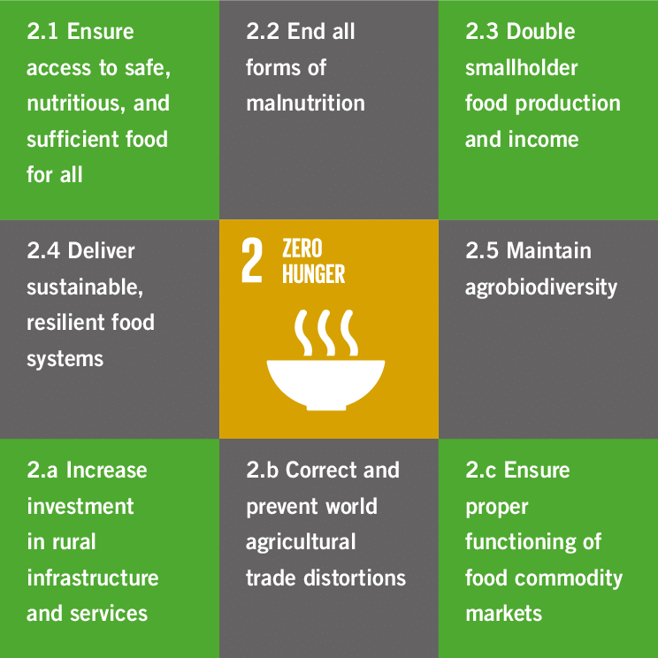
Problem Statement
SDG 2 on ‘zero hunger’ recognizes the need to promote and support:
Small-scale farmers
Sustainable agriculture
Equal access to land technology and markets
Lack of data affects deployment of technology in small scale sector
Notes:
The second sustainable development goal (SDG-2) on ‘zero hunger’ recognizes that, while the number of undernourished people has reduced over the years, there is an urgent need to promote and support sustainable agriculture, small-scale farmers and equal access to land, technology and markets (FAO Assembly, 2015).
The aspect of promotion and support of small-scale farmers and access to technology is particularly important in Africa, because of the rapidly growing population, which places a lot of pressure on the existing available arable land.
SDG 2 aims to double agricultural productivity of small-scale food producers, to promote implementation of resilient agricultural practices that strengthen the capacity for adaptation to climate change, and to increase investment in agriculture through agricultural research and technological development.
These targets need to be aligned with the four pillars of food security, that is, availability, access, utilization, and stability, and their realization is bound to access to up-to-date information resources on agricultural production.
Kenya’s National Agricultural Investment Plan for 2019 – 2024 highlights the limitations of the data that is currently available on agriculture, and the need for an increased capacity to use data from innovation, research and technology in agriculture.
In order to make data available and actionable for agriculture, researchers need to put farmers and agronomists at the center of their work. This will require the integration of extensive ground-truth data collected from the field with high-quality Earth observation data.

Slide 4
Global population increase and urbanization
400k
4M
40M
http://www.urban-hub.com/urbanization/illustrating-the-urban-earth-infographics-on-the-growth-of-cities/
Notes:
- This graphic shows the global population increase particularly in urban areas.
Looking at Africa, as you can see here, we know that this area is the sahara desert, and so by 2030, most of the available arable land will have occupancy of more than 4 million people.
There is already an increase in competition for resources that we rely on for food production, including land and water, which is going to continue intensifying.

Slide 5
Problem Statement
Challenges:
Yield:
Physiological and Ecological Parameters
Protein content:
↑Protein ↑Nitrogen
Pests and diseases:
Crop protection strategies
Serrano et al., (2000); Slafer, G. A., & Satorre, E. H. (1999); Schirrmann et al., (2016).
Notes:
- According to the Food and Agriculture Organization, FAO, Agricultural production will need to increase by 60% over the next forty years to meet the rising demand for food.
Yield is influenced by:
physiological parameters such as the variety or cultivar which determines the Yield potential
Ecological parameters such as temperature, precipitation/ moisture and soil
Economically & Environmentally sustainable approaches are necessary in order to increase yield and protein content while enhancing crop protection
An understanding of these biophysical at varied spatial and temporal scales is important

Slide 6
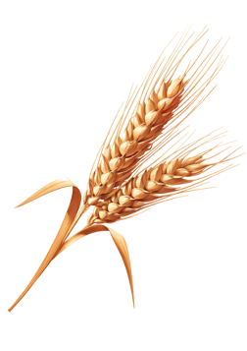
Justification
Biomass and yield estimation
Vegetation and water stress monitoring
Crop acreage estimation
Crop type proportion mapping
Technology-driven agriculture will require data on:
Area of land under cultivation
Types of crops being cultivated
Status of crops (moisture and nutrient content)
Small-scale crop farming is characterized by high spatial and temporal heterogeneity.
Mapping strategies should be able to handle temporally, spatially, and spectrally complex data → Artificial Intelligence / Machine Learning (AI/ ML).
Notes:
As mentioned earlier, in order to realize the targets of SDG-2, access to up-to-date information resources on agricultural production is imperative for farmers and policy makers.
Data on:
The areas of crop cultivation,
The types of crops that are under cultivation, and
The status of crops during the growing season plays an important role in advising farming practices and policy and decision making pertaining to agricultural production and food distribution.
These datasets and information can also aid in the implementation of precision agriculture, thereby helping small-scale farmers to appropriately apply inputs and save on production costs.
In addition, estimation of yield can help the country to plan for food shortages or surplus thus ensuring food security.
Small-scale crop mapping is a non-trivial exercise, which requires procedures that can handle temporally, spatially, and spectrally complex data. This is because small-scale crop cultivation tends to be spatiotemporally heterogeneous and diverse.
Remote sensing imagery acquired by sensors aboard satellites and Unmanned Aerial Vehicles (UAVs) at varying spatial and temporal scales provide an excellent source of data for the mapping and continuous monitoring of small-scale crop cultivation.
AI and ML classification algorithms will aid the derivation of estimates and predictions of crop features and outputs from satellite imagery in five main areas including:
biomass and yield estimation,
vegetation and water stress monitoring,
crop acreage estimation,
crop type proportion mapping and
crop phenological development

Slide 7
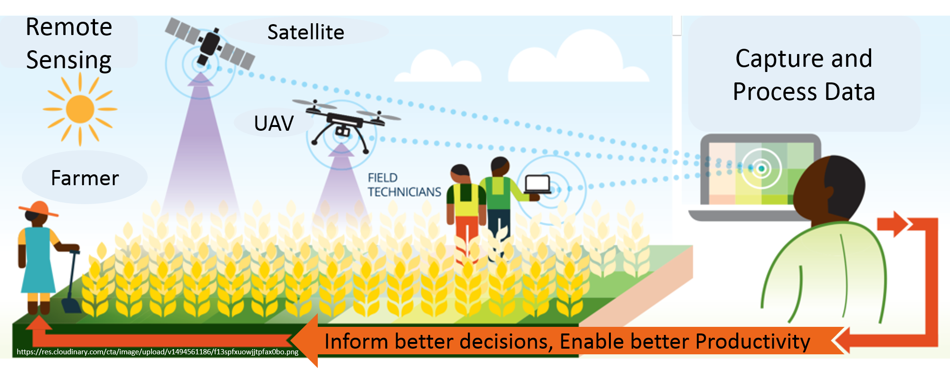
Justification
Space
Nature
Society
Human
Understanding
Sensing → Data
Modeling → Mechanism
Governing Rule
Actions
Management
Policy
Time
Modified from: Sakai (2004)
Notes:
The research we propose today is based on providing and enhancing the understanding of the earth or space that we occupy, which constitutes the interaction between nature, or our natural ecosystems, the human as an individual, and the society, which is the human collective.
In order to enhance and promote the understanding of the earth, we require data, which can be acquired using sensors and measurement devices. This data, when processed and analyzed, will provide information which facilitates modelling in order to understand the various interaction mechanisms in cultivated spaces and their governing rules.
It is our hope that by providing this information, objective policy and action will follow in Kenyan agriculture practice and policy and decision making.
This graphic depicts the overall methodological framework.
We propose the continuous acquisition of satellite imagery from satellite-borne sensors, UAV imagery and field survey exercises towards acquisition of data on land use and land cover.
Once the data is captured and processed, the derived estimates and predictions of crop features and outputs can be delivered to farmers in order to inform better decision making and enable better productivity.

Slide 8
Objectives
Main Objective
To design, develop and implement a web-based application for the access/ download, processing, classification and retrieval of small-scale cropland specific features and outputs.
Specific Objectives
To develop and implement AI/ ML image classification algorithms for mapping of land cover and final estimation and retrieval of crop area, crop status indices and crop yield.
To implement real-time image processing and archiving for retrieval of the Landsat 8/9, Sentinel-2A/2B, and Sentinel-1A/1B images of Kenya, as they become available.
To develop a web-based application for the automatic download of Landsat 8/9, Sentinel-2A/2B, and Sentinel-1A/1B images of Kenya from their respective hubs/ portals.
Notes:
The main objective of this research project will be to design, develop and implement a web-based application for the access/ download, processing, classification and retrieval of small-scale cropland specific features and outputs.
Towards the achievement of this general objective, the specific objectives are:

Slide 9
Methodology
AI/ ML image classification algorithms
Real-time/ Near-real-time image processing algorithms
Web Map Tile Service (WMTS)
Notes:
Towards realization of objective 1, we propose the development and implementation of AI/ ML image classification algorithms for mapping of land cover and final estimation and retrieval of crop area, crop status indices and crop yield.
Automatic AI/ML-driven classification algorithms will be developed and used to generate:
Periodic and regular general land cover classification maps, depicting all classes as outlined by the UN Land Cover Classification System.
The eight major land cover types under this system that are relevant to Kenya include:
(1) Cultivated and Managed Terrestrial Areas,
(2) Natural and Semi-Natural Terrestrial Vegetation,
(3) Cultivated Aquatic or Regularly Flooded Areas,
(4) Natural and Semi-Natural Aquatic or Regularly Flooded Vegetation,
(5) Artificial Surfaces and Associated Areas,
(6) Bare Areas,
(7) Artificial Waterbodies and
(8) Natural Waterbodies
Cropland area extraction will involve extraction of the Cultivated and Managed Terrestrial and Cultivated Aquatic or Regularly Flooded Area classes.
On objective 2 involving the implementation of real-time or near-real-time image processing, background image processing algorithms will be run automatically to various levels, as may be dictated by the user needs, based on their level of expertise and application requirements, as images become available.
The main processing algorithms include:
For the optical datasets, that is, Landsat 8/9 and Sentinel-2A/2B: At-sensor radiance and TOA reflectance, Surface reflectance, Compositing, Cloud Masking and Mosaicking
For the SAR dataset, that is Sentinel 1A/1B: Pixel-wise derivation of the backscatter coefficient through application of orbit file, Ground Range Detected border noise removal, thermal noise removal, radiometric calibration, and terrain correction (orthorectification).
For Objective 3 which will be to develop a web-based application for the automatic download of or access to MODIS Terra & Aqua (Daily, 250m), Landsat 8/9, Sentinel-2A/2B, and Sentinel-1A/1B images of Kenya, a web-based application employing an integration of WMTS client and server applications will be designed, developed and implemented using the GEE Python API.
All the activities as here-in proposed will be implemented using open source software.

Slide 10
Methodology
MODIS
LANDSAT
SENTINEL 2
UAV
TEMPORAL RESOLUTION
SPATIAL RESOLUTION
REAL-TIME
LEAF SCALE
0.002m
ON DEMAND
10m & 20m
5/10 Days
30m
16 Days
250m
Daily
Notes:
This diagram depicts the conceptual framework of our research proposal
Ideally, for effective agricultural management, we require NEAR –REAL-TIME, NEAR LEAF-SCALE information.
However, this is not possible to achieve using datasets from a single sensor.
Therefore we propose the use multi-spatiotemporal datasets which will allow us obtain near-real-time, near-leaf scale information
We therefore intend to implement spatio-temporal image fusion algorithms towards crop mapping and monitoring

Slide 11
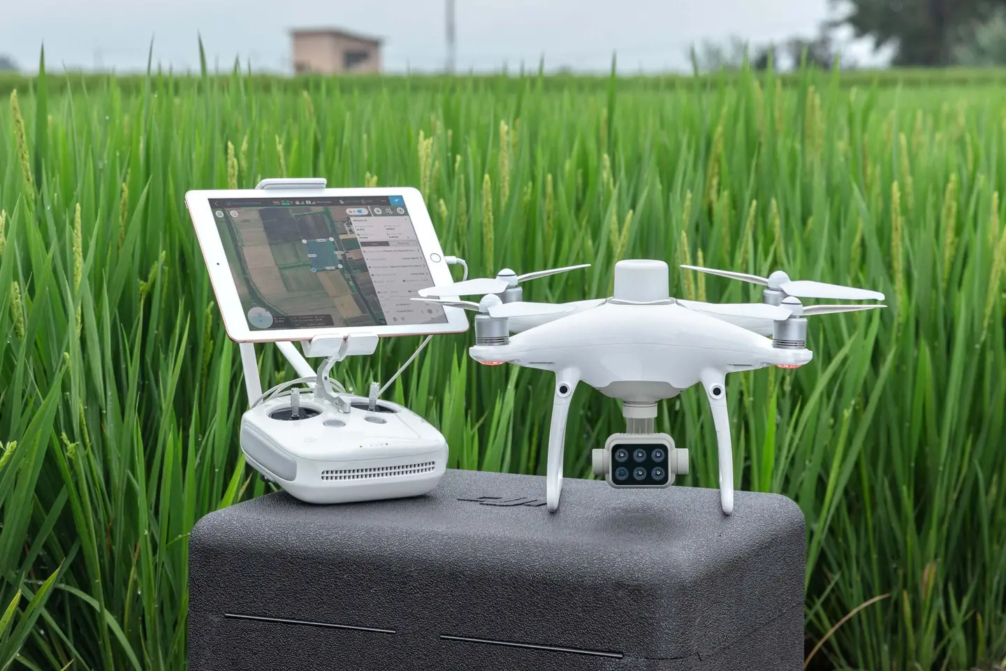
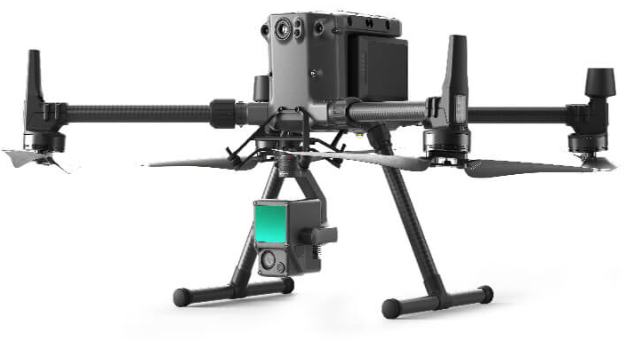
Facilities & Equipment
DJI Phantom 4 Multispectral Drone
DJI Zenmuse L1 - Lidar + RGB Survey Drone
RTK-GNSS Survey base and rover set
Server room
Notes:
Since image classification will require ground reference data collected at regular intervals over the course of the research project, rapid field data collection equipment are required.
We are happy to report that JKUAT possesses two state of the art drones (multi-spectral and LiDAR) and RTK-GNSS survey equipment which will be used for the ground truth data acquisition exercises.

Slide 12
The Team
Name | Department | Role
Dr. Eunice Nduati | Geomatic Engineering and Geospatial Information Systems | Project Lead
Macheche Timothy Simiyu | Geomatic Engineering and Geospatial Information Systems | Student Researcher
Orera Anita Carol Adhiambo | Geomatic Engineering and Geospatial Information Systems | Student Researcher
Evalyne Nyawira Wainoi | Geomatic Engineering and Geospatial Information Systems | Student Researcher
Maureen Mutune Nduku | Soil, Water & Environmental Engineering Department | Student Researcher
Patrick Wendo | Computer Science | Student Researcher
Augustine Ndungu | Computer Science | Student Researcher
Notes:
The JKUAT team is composed of one member of faculty and 6 student researchers drawn from the Departments of
Geomatic Engineering and Geospatial Information Systems,
Soil, Water & Environmental Engineering and
Computer Science.

Slide 13
Expected Results
The following are the expected outputs from the research chair project:
Delivery of cropland area estimation and crop status indices
Automatic image processing algorithms
A Web Map Tile Service (WMTS) for search, discovery and delivery of crop-related features and products

Slide 14
Budget
Activity | Expected Output | Item | Estimated Budget
WMTS design, development and implementation; Compilation and testing of AI/ML Google Earth Engine processing algorithms; Processed imagery archiving; Image classification using AI/ ML algorithms | Web-based application; Processing algorithms; Standards and definition of archive database structure; Processing algorithms; Land cover maps; Cropland area maps; Crop-related indices | Purchase of Hardware and cloud service subscription | 400,000
Ground reference data collection survey | Ground reference data; Spectral response library | Research expenses for personnel (airtime, internet bundles, transport) | 100,000
Total |  |  | 500,000

Slide 15
Thank You. Questions and Comments are welcome…

Slide 16
Auxiliary slides

Slide 17
Methodology
Objective 1:
AI/ ML image classification algorithms for mapping of land cover and final estimation and retrieval of crop area, crop status indices and crop yield.
Capabilities:
General land cover classification
Cropland area extraction
Crop-related indices e.g. NDVI, NDRE, MSAVI, NDMI
Notes:
For objective 1, it will involve the development and implementation of AI/ ML image classification algorithms for mapping of land cover and final estimation and retrieval of crop area, crop status indices and crop yield.
During the client data access request process, users will be required to stipulate which kind of data output they wish to view or download. Bearing in mind that there are hardware limitations in terms of the database and application server storage, we propose that only PNG outputs are made available for download at first.
Automatic AI/ML-driven classification algorithms will be used to generate:
Periodic and regular general land cover classification maps, depicting all classes as outlined by the UN Land Cover Classification System.
The eight major land cover types under this system that are relevant to Kenya include:
(1) Cultivated and Managed Terrestrial Areas,
(2) Natural and Semi-Natural Terrestrial Vegetation,
(3) Cultivated Aquatic or Regularly Flooded Areas,
(4) Natural and Semi-Natural Aquatic or Regularly Flooded Vegetation,
(5) Artificial Surfaces and Associated Areas,
(6) Bare Areas,
(7) Artificial Waterbodies and
(8) Natural Waterbodies
Cropland area extraction will involve extraction of the Cultivated and Managed Terrestrial and Cultivated Aquatic or Regularly Flooded Area classes.
Crop-related indices including the Normalized Difference Vegetation Index (NDVI), the Normalized Difference Red Edge (NDRE) index, the Modified Soil Adjusted Vegetation Index, and the Normalized Difference Moisture Index will be computed as soon as images become available after pre-processing as per objective 1. These indices will be made available for on-demand viewing by clients.
The classification results datasets will not be available in a near-real-time fashion since an ingestion period for accuracy assessment and validation will be required. However, a mechanism to inform users on the availability of classification tiles can be implemented.

Slide 18
Methodology
Objective 2:
Compilation and testing of real-time/ Near-real-time image processing algorithms.
Capabilities:
Landsat 8 and Sentinel-2A/2B: At-sensor radiance and TOA reflectance, Surface reflectance, Compositing, Cloud Masking and Mosaicking.
Sentinel 1A/1B: Backscatter coefficient derivation, GRD border noise removal, thermal noise removal, radiometric calibration, and terrain correction (orthorectification).
Notes:
On objective 2 involving the implementation of real-time or near-real-time image processing, the WMTS server side will automatically run background image processing algorithms to various levels, as may be dictated by the user needs, based on their level of expertise and application requirements.
The main processing algorithms include:
For the optical datasets, that is, Landsat 8/9 and Sentinel-2A/2B: At-sensor radiance and TOA reflectance, Surface reflectance, Compositing, Cloud Masking and Mosaicking
For the SAR dataset, that is Sentinel 1A/1B: Pixel-wise derivation of the backscatter coefficient through application of orbit file, Ground Range Detected border noise removal, thermal noise removal, radiometric calibration, and terrain correction (orthorectification).

Slide 19
Methodology
Source: https://www.researchgate.net/publication/327496231_Current_potentials_and_challenges_using_Sentinel-1_for_broadacre_field_remote_sensing
Notes:
This diagram shows an example of how the back-end image processing can be implemented in relation to the WMTS client for SAR data.
Client-side transactions have to be authenticated, and a valid Region of Interest or ROI provided. Once a valid request is received on the server-side, background image processing algorithms can be implemented.

Slide 20
Methodology
Objective 3:
Design, development and implementation of a web-based Web Map Tile Service (WMTS) based on Google Earth Engine (GEE) Python API.
Capabilities:
Automatic access to/ download of Landsat 8/9, Sentinel-2A/2B, and Sentinel-1A/1B images of Kenya as they become available.
Tiling and caching image collections.
Notes:
For Objective 3 which will be to develop a web-based application for the automatic download of or access to Landsat 8/9, Sentinel-2A/2B, and Sentinel-1A/1B images of Kenya, a web-based application employing an integration of WMTS client and server applications will be designed, developed and implemented using the GEE Python API.
The development process conceptually involves a three-step tile generation process. The first step consists of data collection and transformation into a format suitable for fast query and retrieval. The server application then draws the tile using the prepared data and stores it in a file cache for reuse in the second step. This second step is where the server software generates and caches the tiles on demand. Should the tile be present in the cache, the server immediately delivers it to the client. During this process, the server code can compare the cached tile generation date with the current date and determine whether it needs refreshing. This process would keep the tile data up-to-date. The final step of the process is the tile delivery to the client using an API.
Although the capabilities of the GEE python API are reduced compared to the Java-based Code editor, the Python API can be used on a local machine without the need to utilize a browser. We propose this approach due to the fact that our country faces additional challenges when it comes to harnessing information and processing resources from the internet due to unstable power and internet connections. The ability and option to work offline is therefore important.

Slide 21
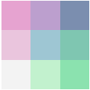
Spatio-temporal Image Fusion
Spatial difference
Fine
resolution
NDVI_{ref}
Coarse
resolution
NDVI_{ref}
Temporal change
NDVI
Coarse
resolution
NDVI_{ref}
Coarse
resolution
NDVI
t₁~t_{n}
t₁
t_{n}
Search for similar pixels
Computation of weights
Fine resolution NDVI
t₁~t_{n}
Zhu et al.(2010); Xia et al. (2018)

